Slide 1

RNS Institute of Technology
(AICTE Approved, VTU Affiliated and NAAC ‘A’ Accredited)
Department of Information Science and Engineering
(Accredited by NBA for the Academic Years 2018-19, 2019-20 and 2020-21)
Data structures Laboratory-18CSL38
CANTEEN MANAGEMENT SYSTEM
Carried out by
Shreeya Prakash(1RN20IS150)
Shreshta Mallikarjun (1RN20IS151)
Shresth Sachan(1RN20IS152)
Shreya Choontharu(1RN20IS153)
Shreya Bharadwaj(1RN20IS154)
Staff in Charge: Mrs. Sunitha
Designation: Assistant Professor

Slide 2
CONTENTS
Sl.no | Topic
1. | Abstract
2. | Introduction
3. | Objectives
4. | Data structure used
5. | Visual representation
6. | Implementation and Result
7. | Conclusion and further enhancements

Slide 3
Abstract
Canteen Management Software is an automated software which enables all the activities of the canteen and maintain a detailed account of food served at the canteen.
It helps management to handle the users by reducing the waiting time for the customers.
It is user interactive.
The data structure used is doubly linked list which makes the traversing efficient.

Slide 4
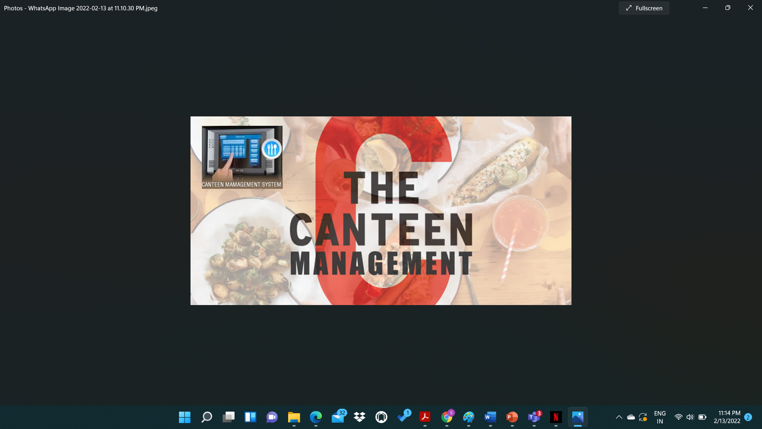
Introduction
Canteen Management Software is an automated software which enables all the activities of the canteen and maintain a detailed account of food served at the canteen.
It allows secure and speedy transactions. It helps management to handle the users by reducing the waiting time for the customers.

Slide 5
Objective of the project
TO TRACK ORDER AND SALES.
DISPLAY ORDER.
TO TRACK ORDERS AND SALES.
DISPLAY FINAL BILL.
TO PROVIDE SERVICE FACILITY TO RETAURANT AND ALSO TO THE CUSTOMER.

Slide 6
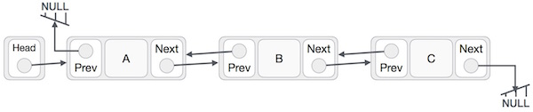
DATA STRUCTURE
Doubly linked list is a complex type of linked list in which a node contains a pointer to the previous as well as the next node in the sequence.
The node consists of three parts: node data, pointer to the next node in sequence -next pointer , pointer to the previous node -previous pointer.

Slide 7
Data Structure
Doubly linked lists are dynamic data structures. i.e., they can grow or shrink during the execution of a program.
Linked lists have efficient memory utilization. Here, memory is not pre-allocated.
Insertion and Deletions are easier and efficient. Linked lists provide flexibility in inserting and deleting.
Reversing the doubly linked list is very easy.
The traversal of this doubly linked list is bidirectional which is not possible in a singly linked list.
Deletion of nodes is easy as compared to a Singly Linked List.

Slide 8
VISUAL REPRESENTATION

Slide 9
CANTEEN MANAGEMENT SYSTEM
ADMIN
CUSTOMER
EXIT
DELETE ITEM
DISPLAY MENU
PLACE ORDER
DELETE ITEMS
DISPLAY MENU
VIEW ORDER
DIPLAY BILL
BACK TO MAIN
BACK TO MAIN

Slide 10
Login to the canteen management system
Start
Check user level and permissions
Check permission
Check permission
Check permission
Check permission
Check permission
Manage canteen
Manage product
Manage order
Manage food items
Manage bills
Logout from the system
end

Slide 11
Implementation modules
Struct node* createcustomer():​
We are allocating the memory to the new1.​
Using a flag variable to tell if a condition is true or false.​
Inside the while loop if the flag is equal to 1 then we will be giving the values (ex: data, price ,quantity).​
There is an else condition informing that a particular item is not there in the menu.​

Slide 12
​Struct node* createAdmin():​
The memory is allocated to new1.​
The values of data, price , quantity are assigned.​
strcpy() is used for adding the food name.​
We are having a while loop inside else condition in which the right pointer(rptr) will be traversing till NULL.​
We will be assigning the value of new1 to the rptr of temporary variable and the value of new1 to taila.​

Slide 13
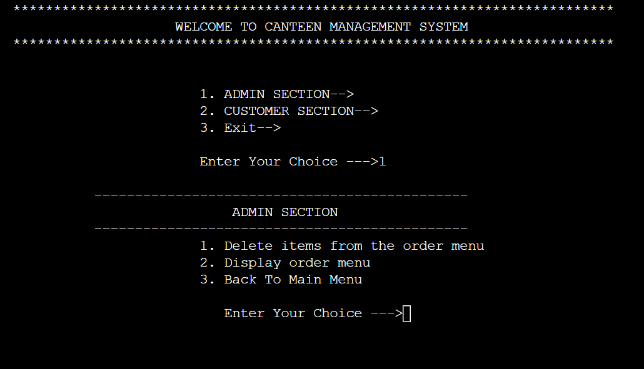
RESULT

Slide 14
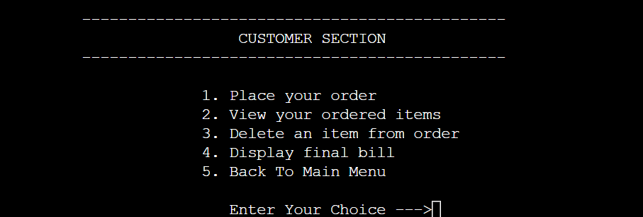
CUSTOMER SECTION

Slide 15
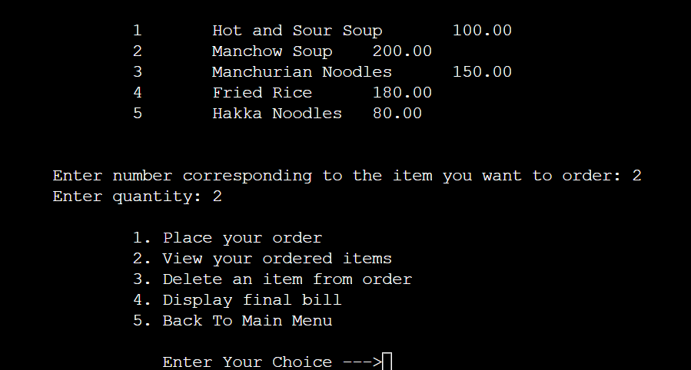
PLACING AN ORDER

Slide 16
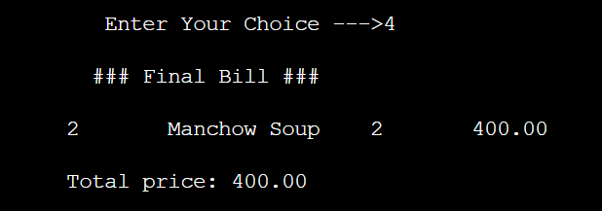
FINAL BILL

Slide 17
FOR THE SOURCE CODE CLICK HERE

Slide 18
Conclusion & Future Enhancements
This presentation is an overall conclusion about how Canteen Management System works.
This system is efficient in maintaining customer’s details and also handles the information of products available in a canteen.
For example, in the ‘new normal’ canteens have gone contactless by introducing contactless payments and other online ordering services.
Canteens with their own websites provide a smooth and hassle-free service like online ordering
We will store customer details for future reference.

Slide 19
THANK YOU

